Slide 1
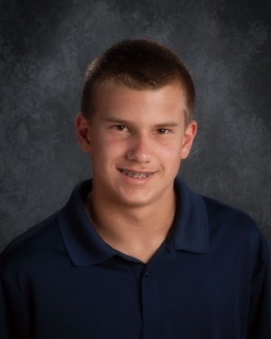

Michael Malecha
Diagnosed August 25, 2014 with LHON

Slide 2
What is LHON
Leber's Hereditary Optic Neuropathy
Mitochondrial disease only passed by the mother
The mitochondria that has a mutation can at some point in time function improperly to produce less adenosine triphosphate (ATP) (this is the high-energy molecule that stores the energy we need to do just about everything we do) and more Reactive Oxygen Species (ROS) causing the cells in the optic nerve to die off
Male carriers have a 50/50 chance of becoming affected and female carriers have an 8% chance
Males usually become affected between the age of 15 to 25 and females at menopause
From initial vision change to central blindness is usually 6 to 8 weeks
96% of the affected carry one of the 3 major mutations 11778, 14484, 3460
Most doctors have no clue what LHON is

Slide 3
My Journey
On August 20, 2014 I went for a physical and was asked to do the eye chart. My right eye was 20/15 and I couldn't see the eye chart with my left eye. My mom thought I needed glasses. The next day I went to the eye doctor and found out I didn't have central vision in my left eye. The eye doctor sent me to a retinal specialist. They made an appointment with a neuro-ophthalmologist at the U of M on August 25, 2014. He ran some tests and looked at my parents and me and said, “I believe you have a disease called Leber's Hereditary Optic Neuropathy and you will most likely be centrally blind in 6 to 8 weeks.”

Slide 4
In October we received the news that I tested negative for the 3 major mutations of LHON. My vision hadn't changed and the Dr. at the U of M decided that maybe I had a virus that made my central vision go, but it was lurking in the back of our minds I could be in the 4% chance of having an odd mutation. Life went on until the 1st week of March 2015 when my right eye (my so called good eye) began to show signs of black spots.

Slide 5
Back to the U of M we went and there were signs that the optic nerve in my right eye was swelling. A full Mitochondrial DNA test was done. On June 5, 2015 our last day of school, the results came showing that I do carry a rare genetic mutation with the number of 3890 and there have only been a few people in the whole world with the same mutation.

Slide 6
LHON CONFERENCE 2015
On June 15, 2015 my mom and I went to a conference on LHON in Washington, DC. We met 33 people who have the same eye disease. All seemed to be affected with one of the 3 major mutations. I felt like I was the only one who had an odd mutation. Each of us had our own story and journey. The age ranged from people in their 70's down to 14. Men and women both. This was a wonderful experience for both my mom and me. We met 3 research doctors and they are working on trying to find a cure. One doctor is from the US.

Slide 7
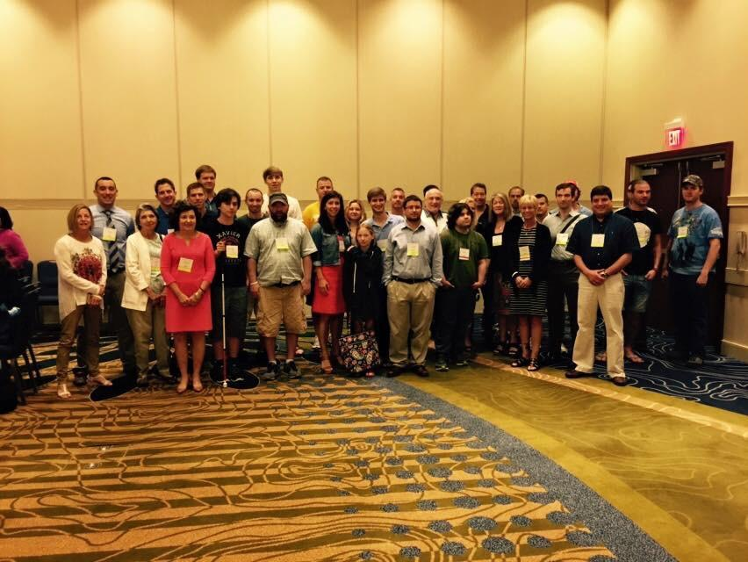
Others I met affected with LHON in Washington DC

Slide 8
WHAT I SEE TODAY
As of right now I am considered legally blind. My vision in both eyes is 20/250. This doesn't mean that I cannot see it means my vision is very bad. I am no longer able to drive. When crossing streets I cannot see if the stoplight is telling me to walk or not. The font size at this point in time I am able to read is size 26 bold, but is slow going. This also depends on the day. Some days are better than others, meaning my vision is constantly changing.

Slide 9
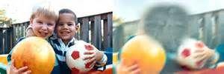
A normal person without LHON would see like this on the left and on the right is what a person with LHON sees
Right now I can see your face when we are standing and talking. I can see if your eyes are opened or closed or if you have glasses. I cannot tell what color your eyes are. That is from a distance of 5 ft.

Slide 10
WHAT I NEED HELP WITH IN SCHOOL
I cannot see the board or things you are doing in detail more than 2 feet in front of me.
When I read I have to hold items close to my face.
I use a magnifier on my cell phone or a magnifier called a Ruby.
At school I am using a VisioBook that has a camera so I can see what you are doing on the board and worksheets that you hand out.
I use my apple computer with voice over and the magnifier to complete my work.
At home I have a CCTV which is like my VisioBook but on a larger scale.

Slide 11
Please be patient with me as I am having to relearn everything that has been taught to me over the past 11 years with vision, to now doing it with limited vision. I have to learn new technology, listening to books instead of reading and needing to work on my short term memory.
I am willing and most certainly able to learn.

